Slide 1
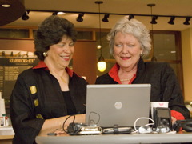
Flipped Classroom:
Flying High or Flopping? Why?
Dr. Barrie Jo Price
And
Dr. Anna C. McFadden

Slide 2

www.emTech.net
Barrie Jo Price, bjprice@ches.ua.edu SKYPE: barrie.jo.price
Anna McFadden, amcfadde@emTech.net SKYPE: amcfadde

Slide 3

What is a Flipped Classroom?
Flip Your Classroom: Reach Every Student in Every Class Every Day
(from ASCD)
Flipped classroom pioneers
Aaron Sams and Jonathan Bergmann

Slide 4


Slide 5
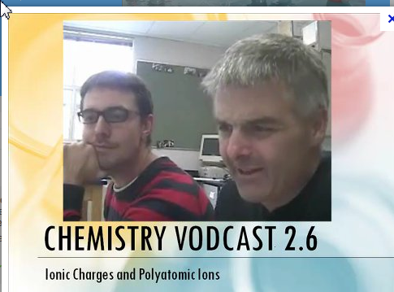
What is the flipped classroom?
"In this model of instruction, students watch recorded lectures for homework and complete their assignments, labs, and tests in class."

Slide 6


Book from ISTE.org

Slide 7
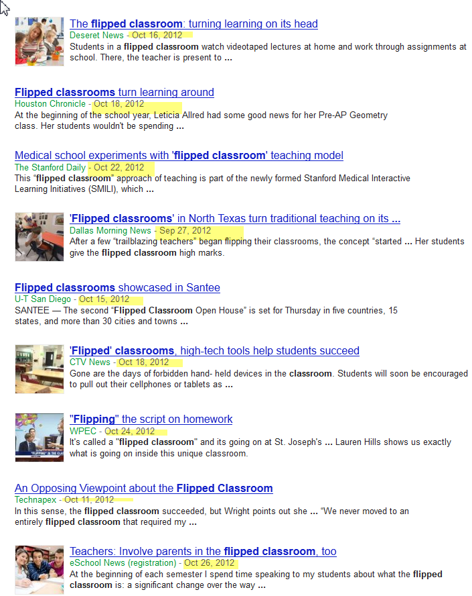

Slide 8
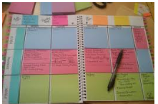
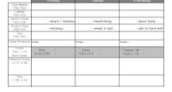
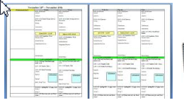

Where does teaching/learning occur?

Slide 9
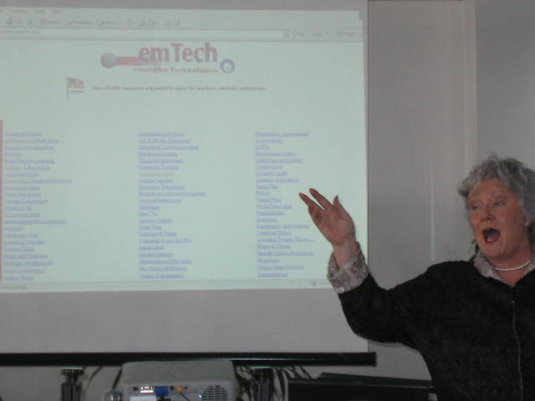
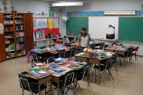
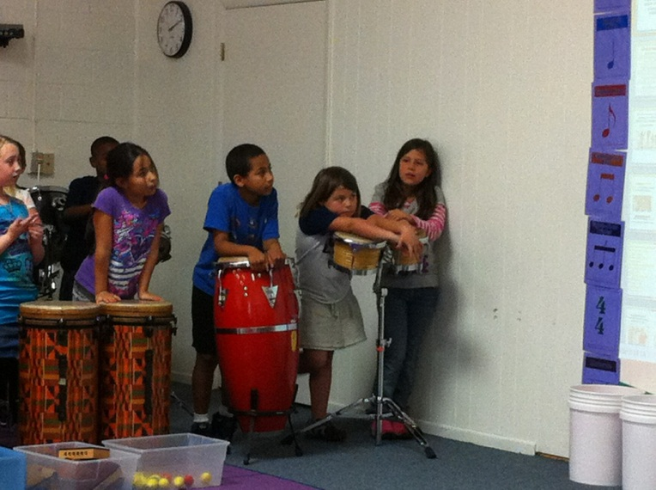
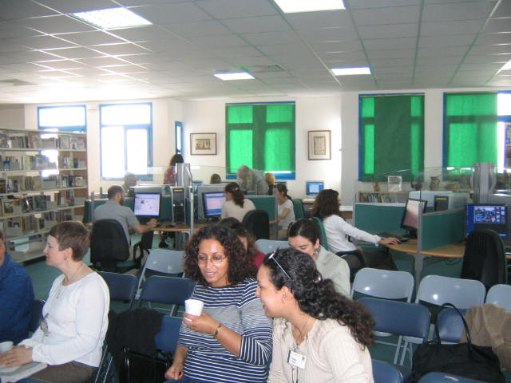
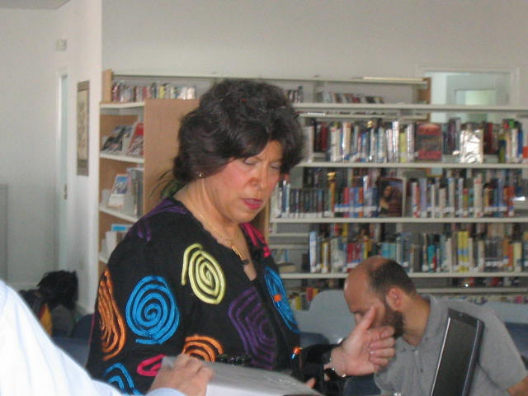
Where does teaching/learning occur?

Slide 10
Where does teaching/learning occur?
Traditional Classroom Planning
Flipped Classroom Planning
L
Location
Timing
Purpose
Responsibility
Location

Slide 11

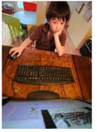
Location

Slide 12
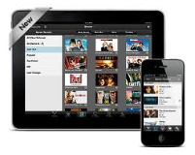
Location

Slide 13


Timing

Slide 14

Purpose
Acquire Knowledge
Address Schedule = time on task
Address Schedule = calendar
Use Technology

Slide 15
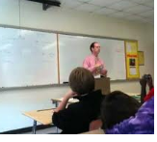

Responsibility

Slide 16
Examples of Flipping
Video for lectures
Customized video watching
Small Group Work by SKYPE
Peer reviewing on a wiki or blog

Slide 17
Pros and Cons
More than video lectures ….but….
Is only one way….but….
Changes teacher’s role….but…
Requires technology tools….but…

Slide 18
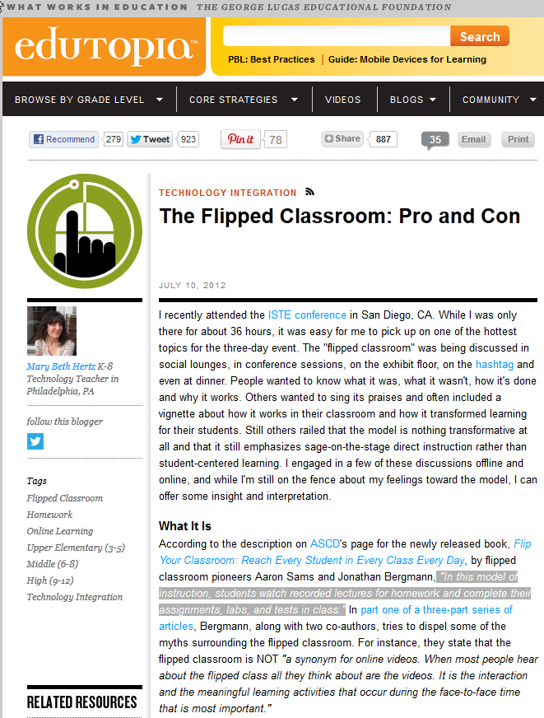
http://www.edutopia.org/blog/flipped-classroom-pro-and-con-mary-beth-hertz

Slide 19

http://www.thedailyriff.com/articles/the-flipped-class-conversation-689.php

Slide 21
www.emTech.net
Barrie Jo Price, bjprice@ches.ua.edu SKYPE: barrie.jo.price
Anna McFadden, amcfadde@emTech.net SKYPE: amcfadde

