Slide 1
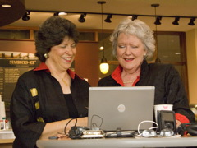
YouTube and Teachers:
Make Your Debut!
Dr. Barrie Jo Price
And
Dr. Anna C. McFadden

Slide 2
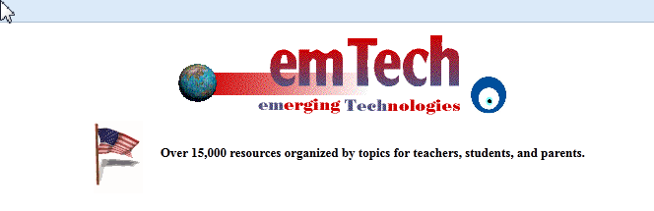
www.emTech.net
Barrie Jo Price, bjprice@ches.ua.edu SKYPE: barrie.jo.price
Anna McFadden, amcfadde@emTech.net SKYPE: amcfadde

Slide 3

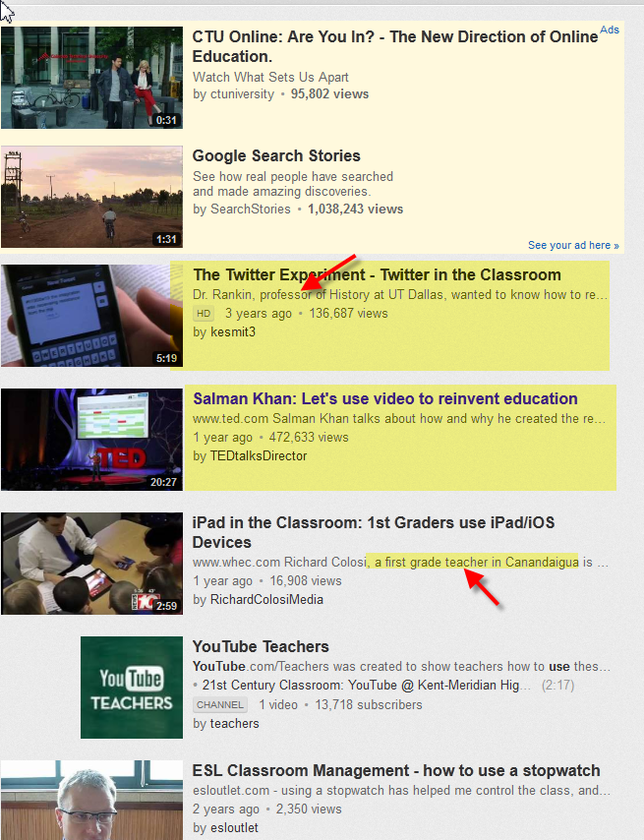

Slide 4
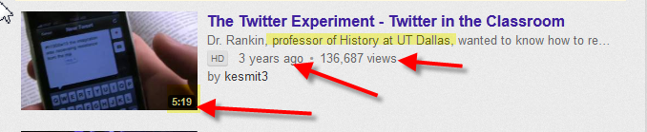
YouTube and Teachers

Slide 5
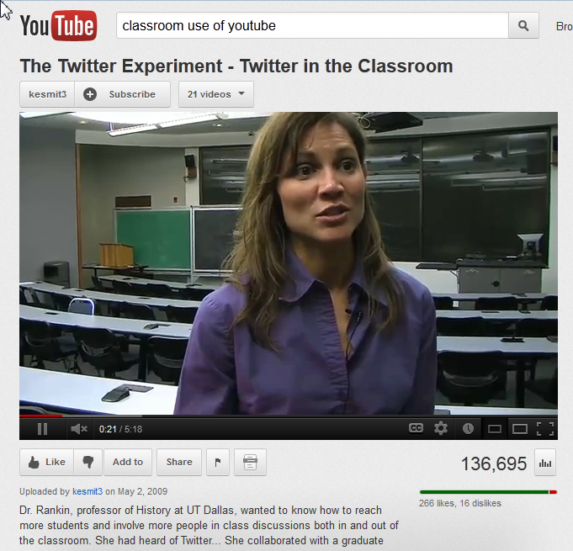

Slide 6
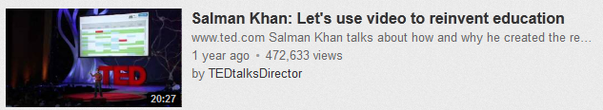
YouTube and Teachers

Slide 7
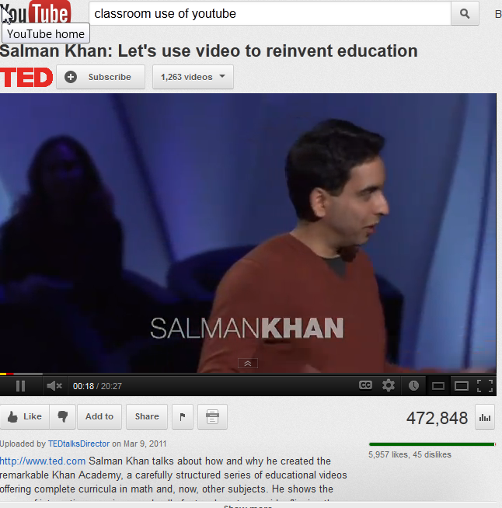

Slide 8
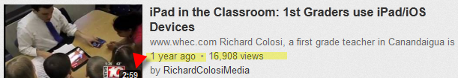
YouTube and Teachers
News story about a 1st grade teacher and his class using iPads.

Slide 9
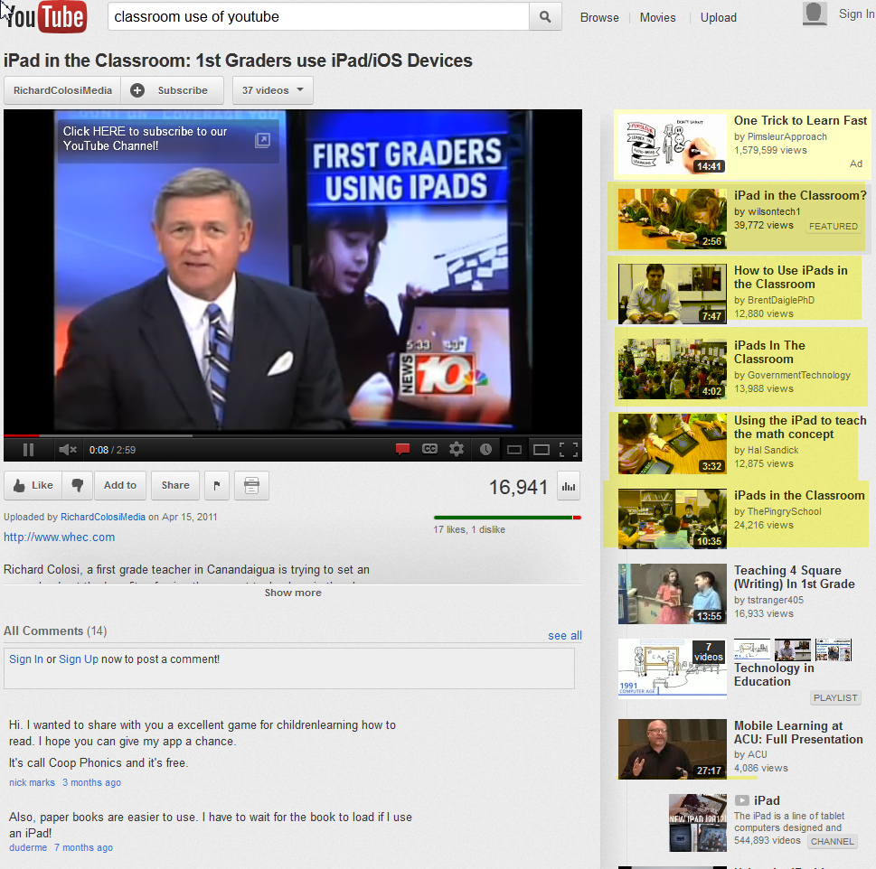

Slide 10
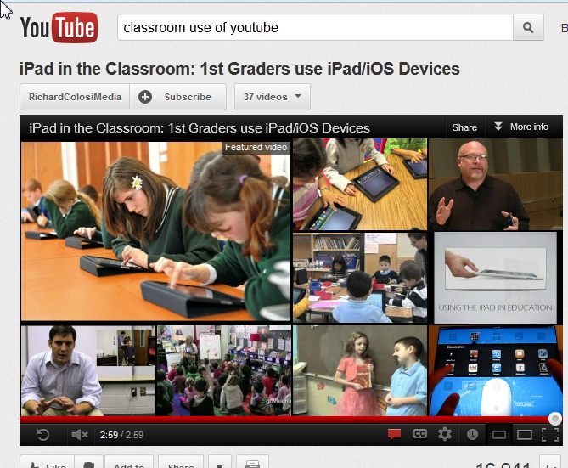
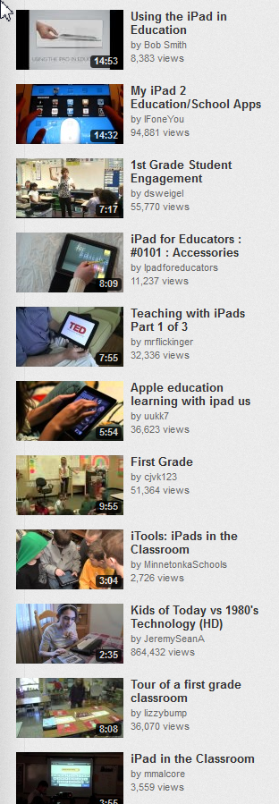

Slide 11
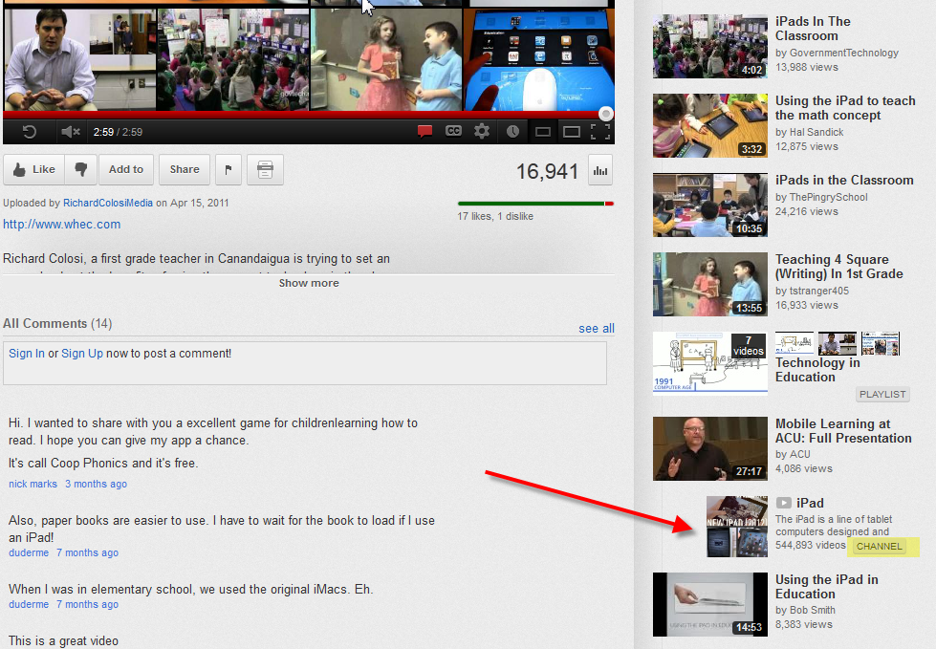

Slide 12

But one is different…
CHANNEL

Slide 13
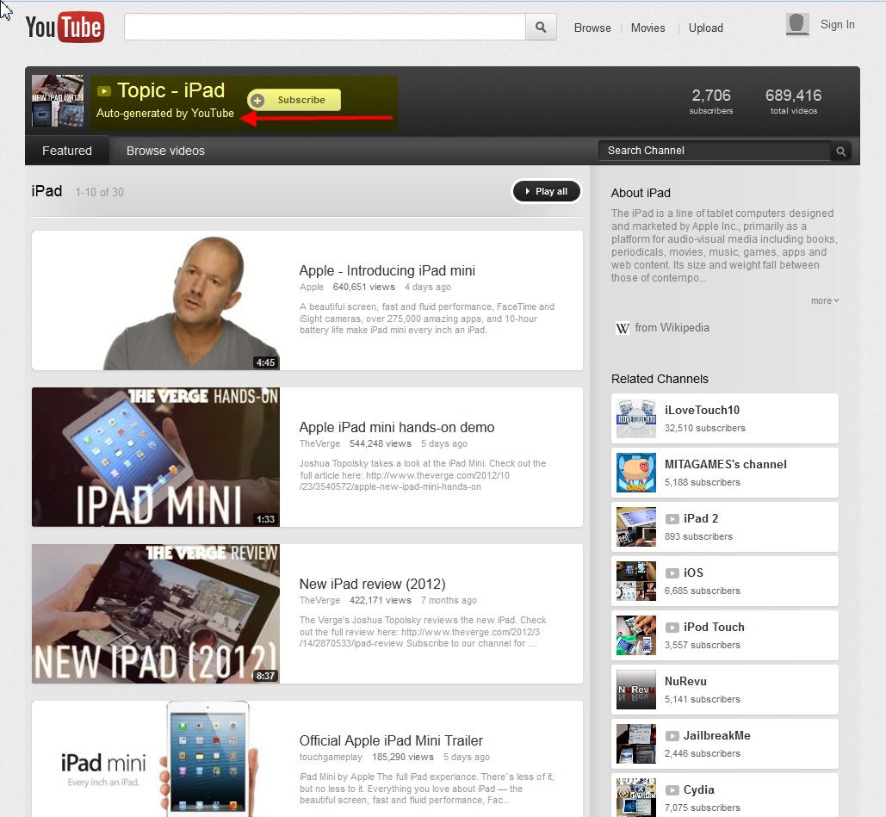
CHANNEL on YouTube
"

Slide 14
CHANNEL on YOUTUBE
HOME PAGE FOR AN ACCOUNT IS A CHANNEL.
SHOWS:
Account name
Account type
Public videos uploaded
Any user information entered.
AND
favorite videos from other users
activity streams, comments, subscribers,
other social networking features.

Slide 15
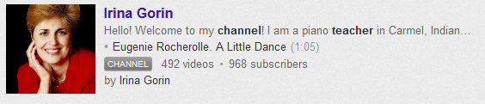
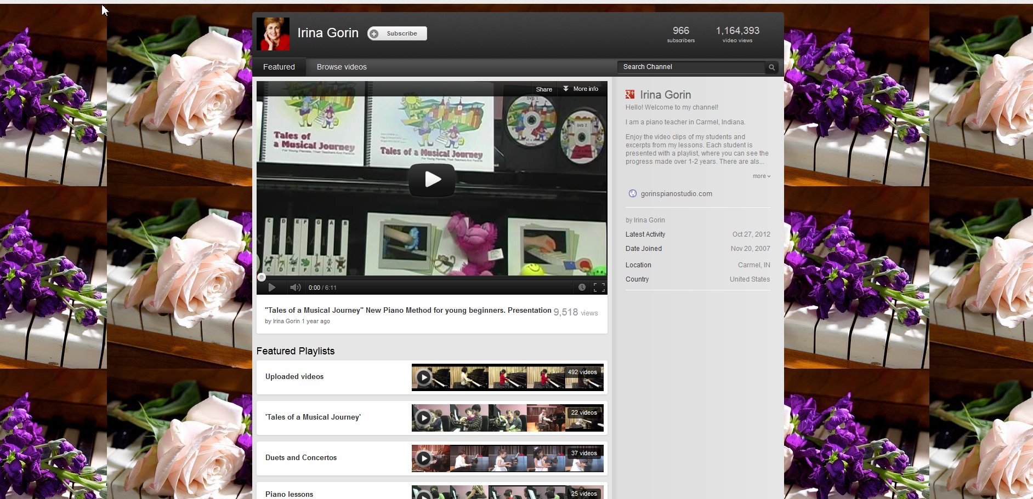

Slide 16
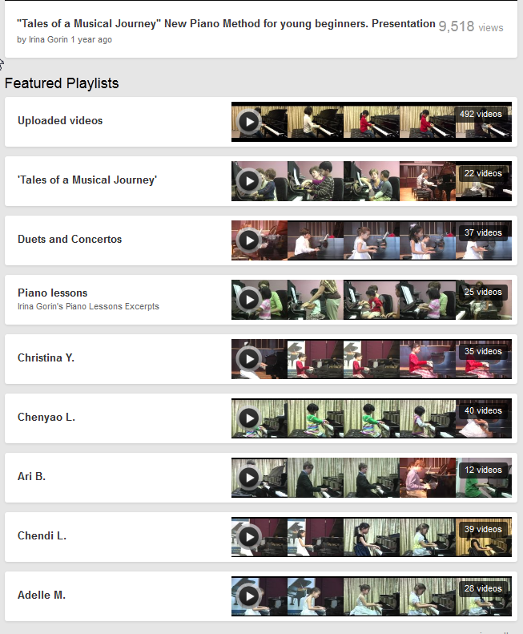
She features her students playing

Slide 17
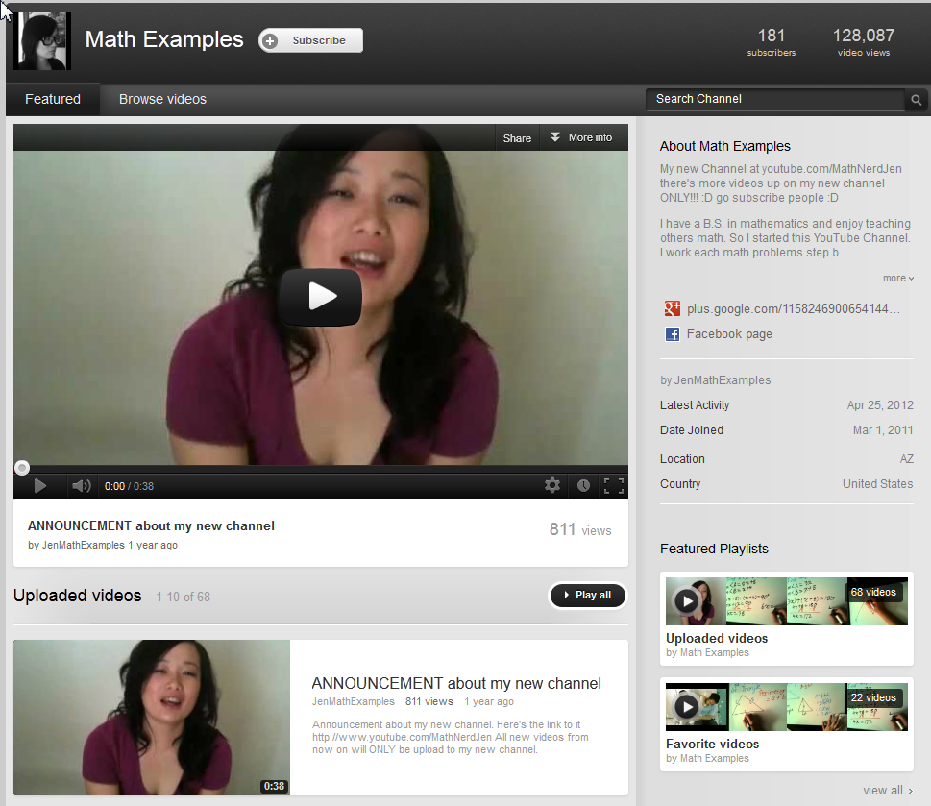
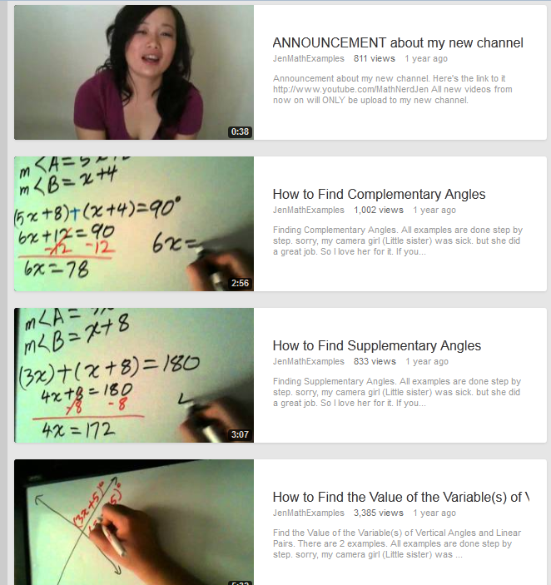
MATH TEACHER’S CHANNEL
http://www.youtube.com/user/jenmathexamples?feature=results_main

Slide 18
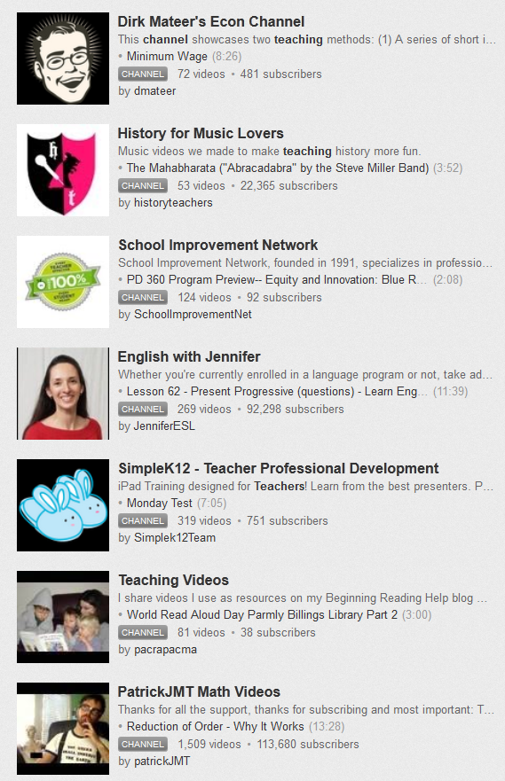
Flipped
L
Location

Slide 19
Should I have a channel?
Have you ever found a YouTube video you wanted to share with your class?
Have you ever thought that you did a great job of teaching a particular concept, theme or such?
Do you have a web cam?

Slide 20
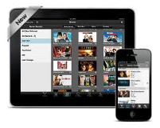
Your Students Can Use Channel

Slide 21
You Tube and You
Create a channel
  Link to videos you want the students to see
  Create original videos
Help YouTube with Classroom Videos
Have students make videos

Slide 22
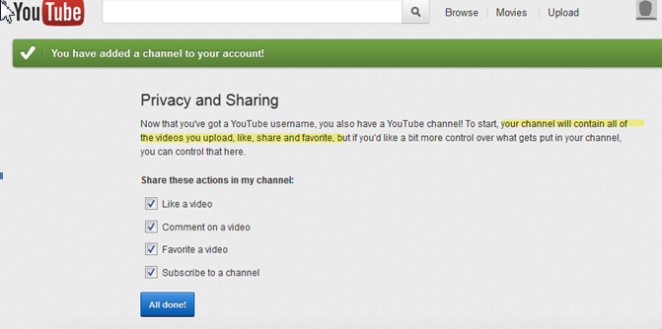
Your Channel:
Your Own Videos, Those You LIKE, SHARE and FAVORITE

Slide 23
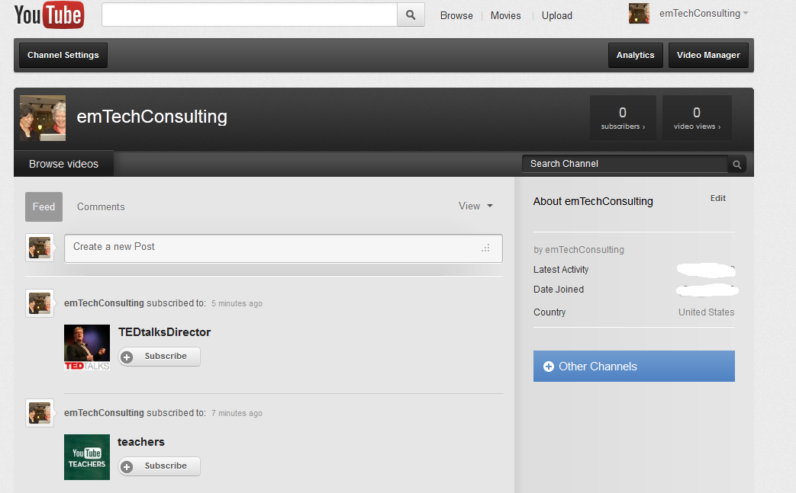
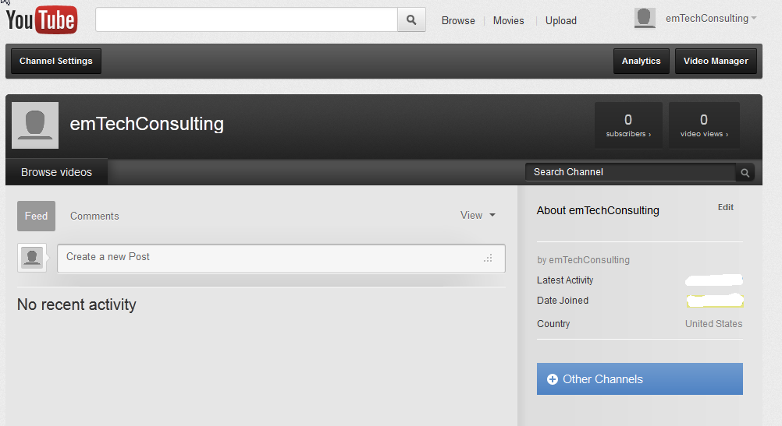
http://www.youtube.com/emTechConsulting

Slide 24
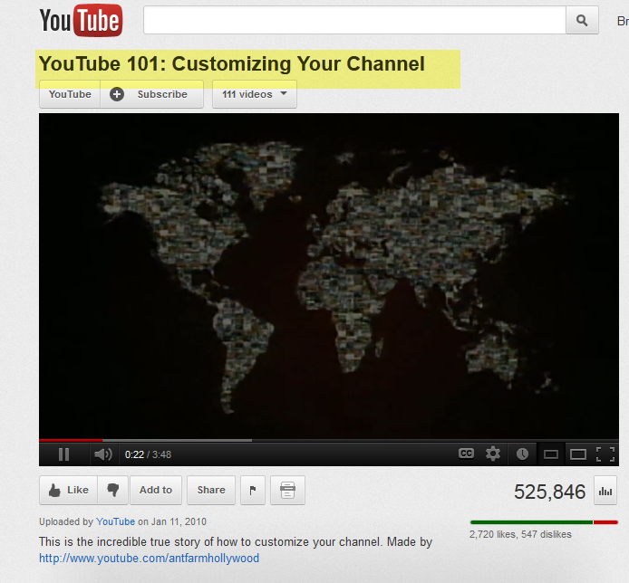
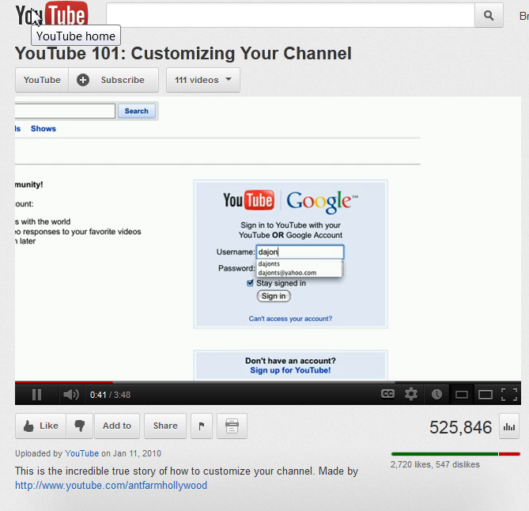
http://www.youtube.com/watch?v=NykI2cJ9o80
How to Customize Your Channel 3:48 minutes

Slide 25
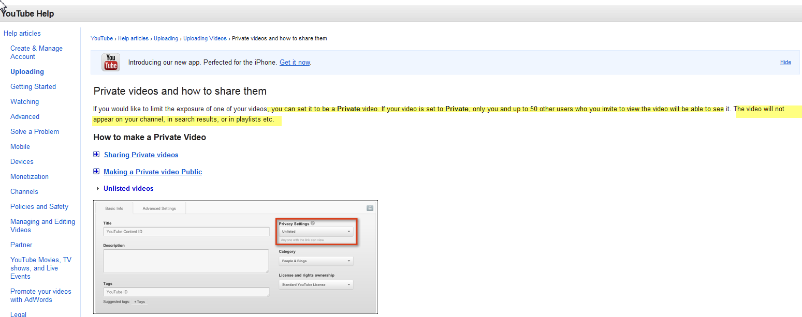
Your Channel: Private Videos

Slide 26
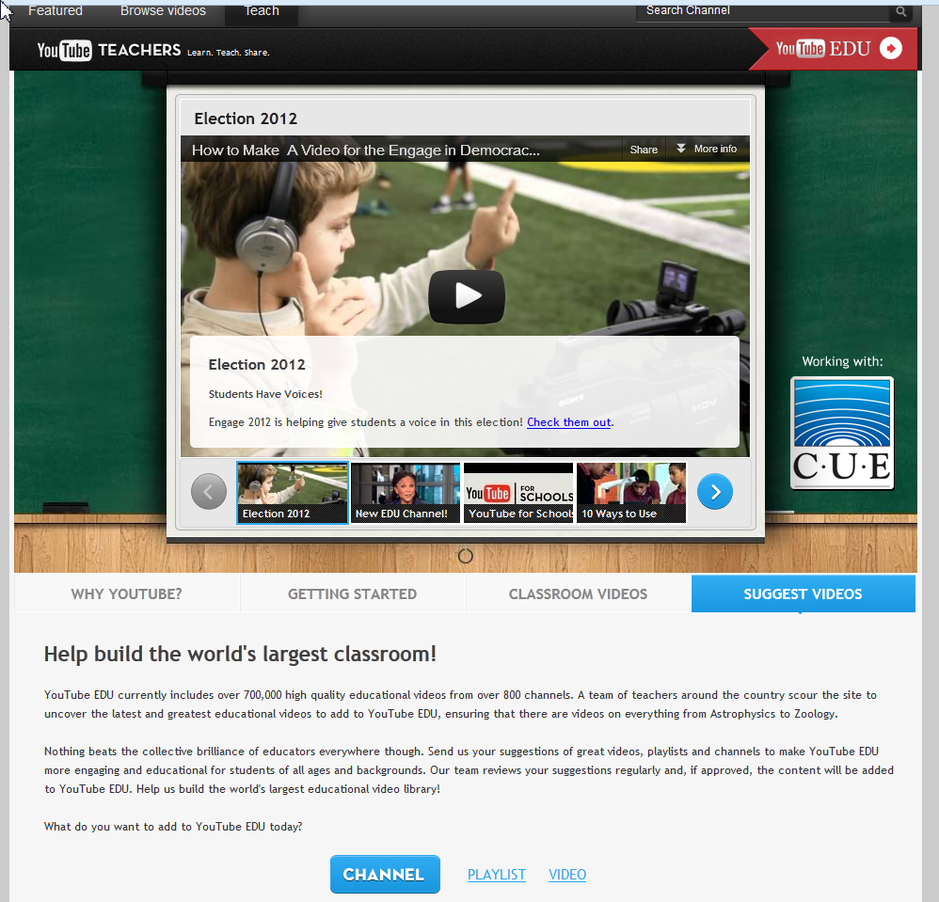

Slide 27
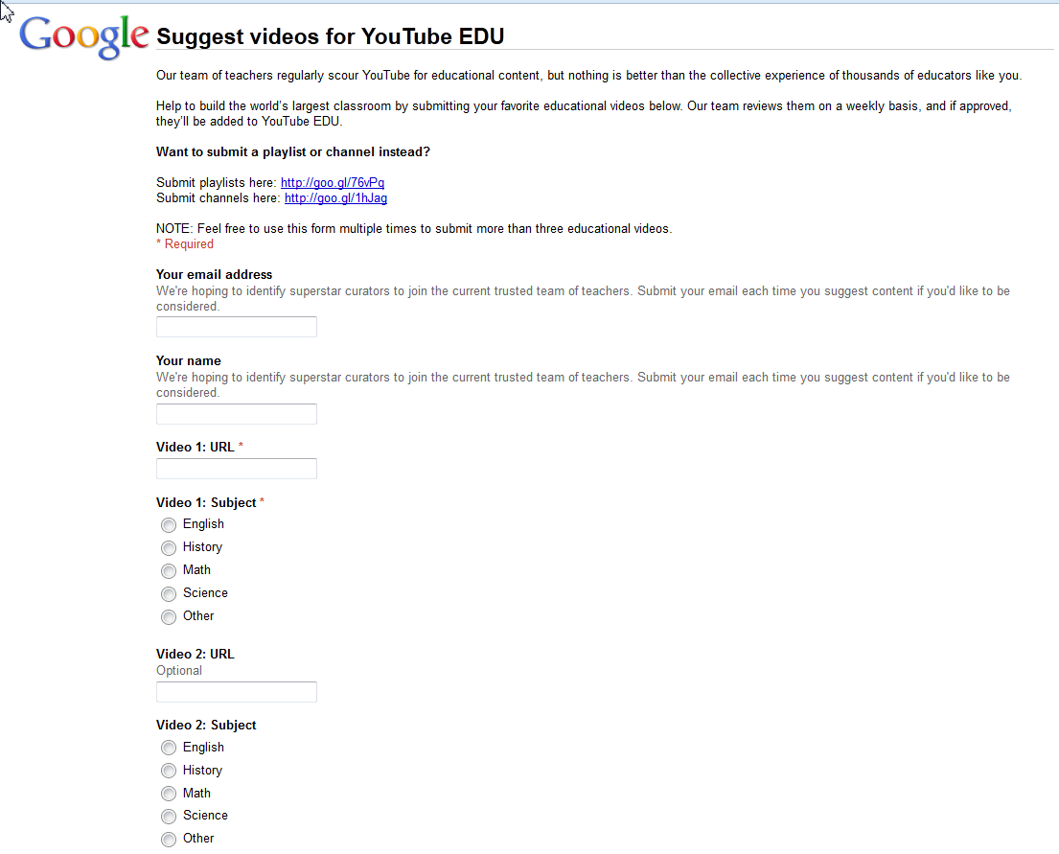

Slide 29
www.emTech.net
Barrie Jo Price, bjprice@ches.ua.edu SKYPE: barrie.jo.price
Anna McFadden, amcfadde@emTech.net SKYPE: amcfadde

